Slide 1
Google-Play-Apps Analysis and App Rating Prediction using ML Models
Srinivas Naidu Pasyavula
QC61851
DATA 603
Prof. Donghwa Kim

Slide 2
Table of Contents
Abstract
Data Set Description
Data Analysis
Data Visualization
ML Models - App Rating Prediction
Conclusion

Slide 3
Introduction:
The Google Play Apps and Games dataset available on Kaggle contains information on over 100,000 apps and games that are available on the Google Play Store.
The dataset includes information on app features such as category, rating, size, price, and reviews, as well as developer details and other metadata.
The dataset is useful for conducting analyses related to app performance and user engagement, as well as for training machine learning models to predict app ratings or to identify trends in app development.

Slide 4
Dataset Description:
Data Source - Google Play Apps Data Set
Provenance source - https://play.google.com/
Size - 1.6GB
Format - CSV
Number of Columns - 36
Number of Rows – 1046731
Coverage - 02/10/2009 to 11/01/2022
GEOSPATIAL COVERAGE - US

Slide 5
Data Analysis
AWS Cloud Service – S3 Bucket
The data is been pre-processed for further analysis.
EDA:
Check for null or duplicate values
Handling the missing data
Data formatting
Determining the schema of the data frame.

Slide 6
Data Visualization
Number of Free Apps and Paid Apps
Which Genre has the highest number of applications
How many applications support and do not support In-App Purchases
Ratings according to the Genre of Applications
Distribution of App Scores
Average Number of Reviews by Genre
Number of Apps Released by Year

Slide 7
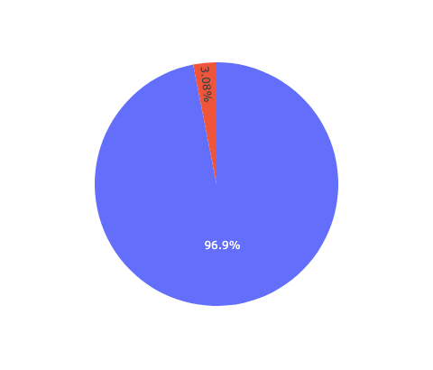
Number of Free Apps and Paid Apps
96.9% of the apps are free and 3.08% of the apps are paid

Slide 8
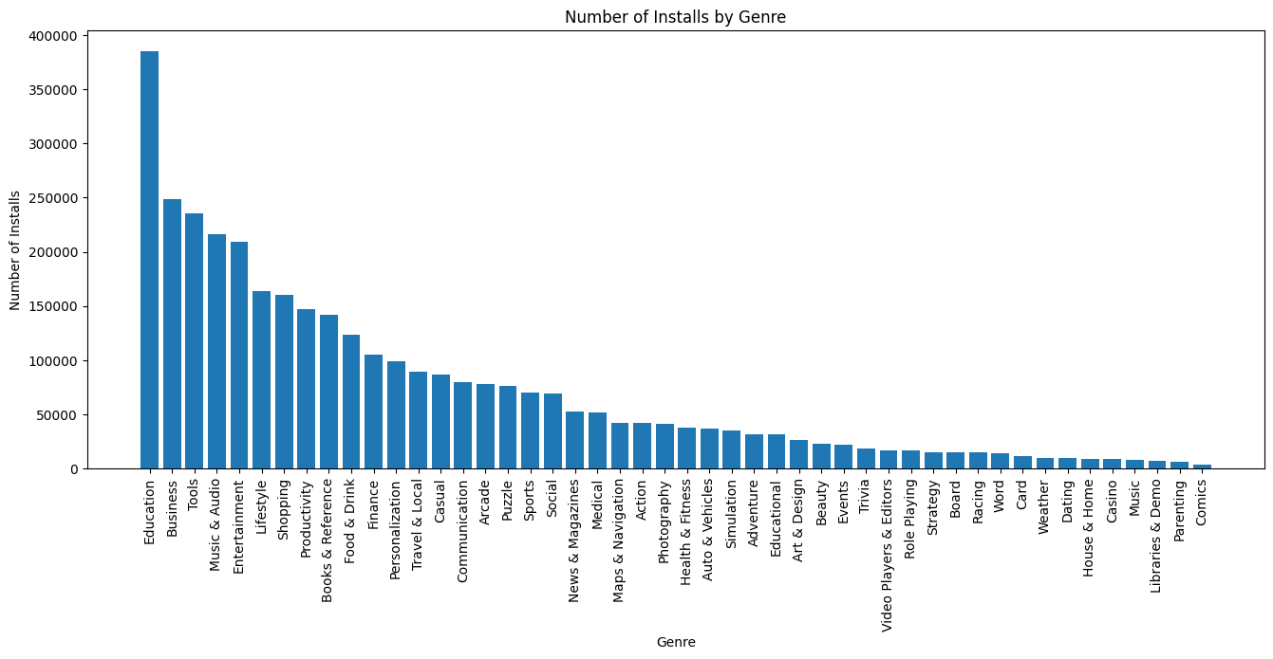
Which Genre has the highest number of applications
Education is the highest genre to be installed with approximately 4L.

Slide 9
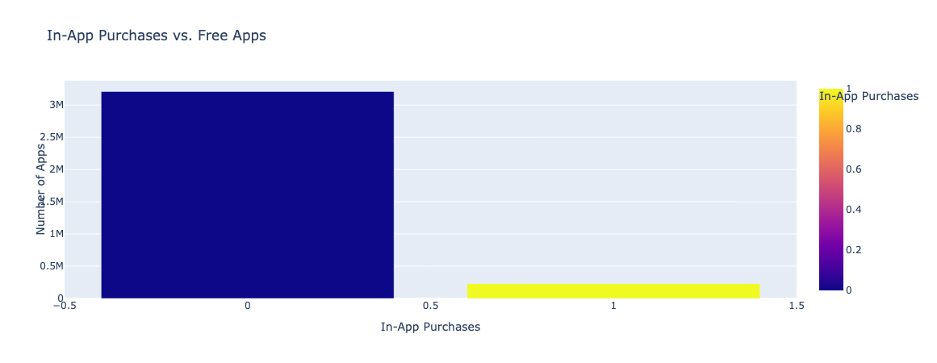
How many applications support and do not support In-App Purchases
There are 3M + applications has In-App Purchases

Slide 10
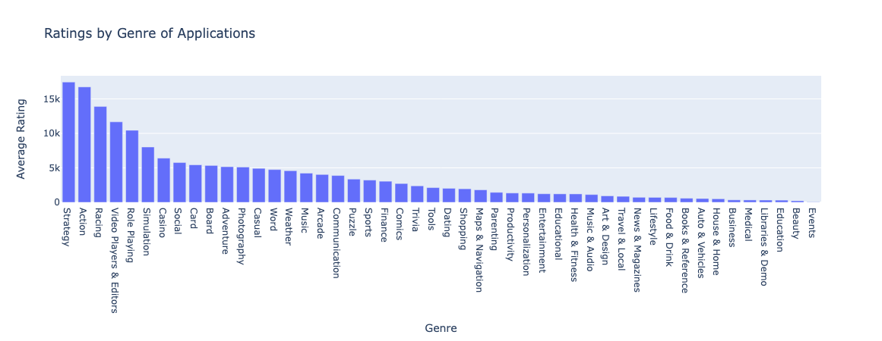
Ratings according to the Genre of Applications
The strategy has the highest number of Ratings

Slide 11
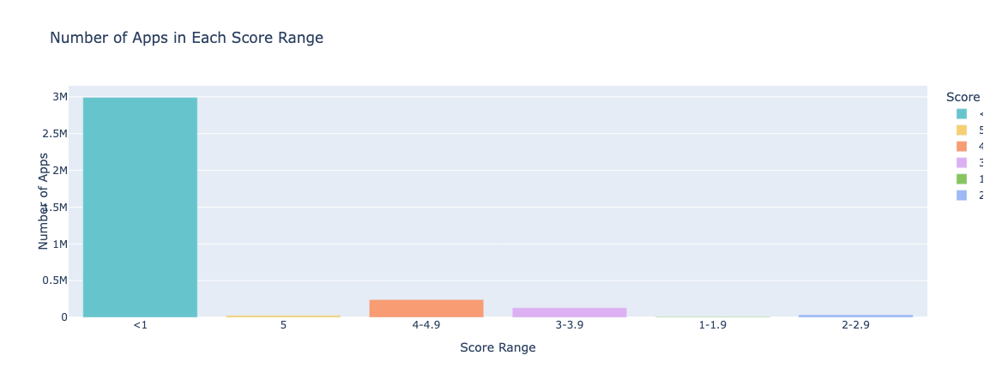
Distribution of App Scores

Slide 12

Average Number of Reviews by Genre

Slide 13
Data Insights -
There are a greater number of Free Apps than Paid Apps
The education Genre has the highest number of Applications followed by Business, Tools, and Comics with the least.
There are 3M + applications has In-App Purchases
Most Ratings are for Strategy and Actions, the Events genre with the least
1-star ratings dominate the score of the Applications
The highest number of Applications is from Education Genre in contrast Ratings and Reviews are the least.

Slide 14
ML Models - App Rating Prediction
Random Forest Model
Root Mean Squared Error (RMSE) of Random Forest Model: 0.1735
Linear Regression
Root Mean Squared Error (RMSE) of Linear Regression Model: 1.3444

Slide 15
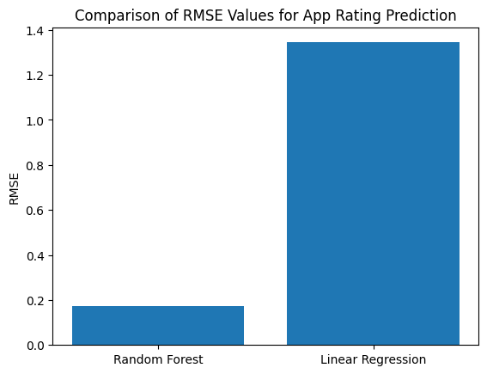
Random Forest vs Linear Regression

Slide 16
Conclusion
A lower RMSE value indicates better predictive performance, so in this case, the Random Forest model with an RMSE of 0.1735 is better than the Linear Regression model with an RMSE of 1.3444.
The reason for this is that Random Forest is a more powerful algorithm for predicting outcomes in complex datasets, which can lead to better performance than simpler algorithms like Linear Regression. Random Forest models are also less prone to overfitting, which can result in better generalization to new data.
Based on the given information, we can conclude that the Random Forest model performs better than the Linear Regression model for predicting app ratings. The RMSE value for Random Forest is lower than the RMSE value for Linear Regression, indicating that the Random Forest model has better predictive power. Additionally, Random Forest is generally more robust to outliers and non-linear relationships between the predictors and the response variable, which could explain its better performance in this case.

